Slide 1
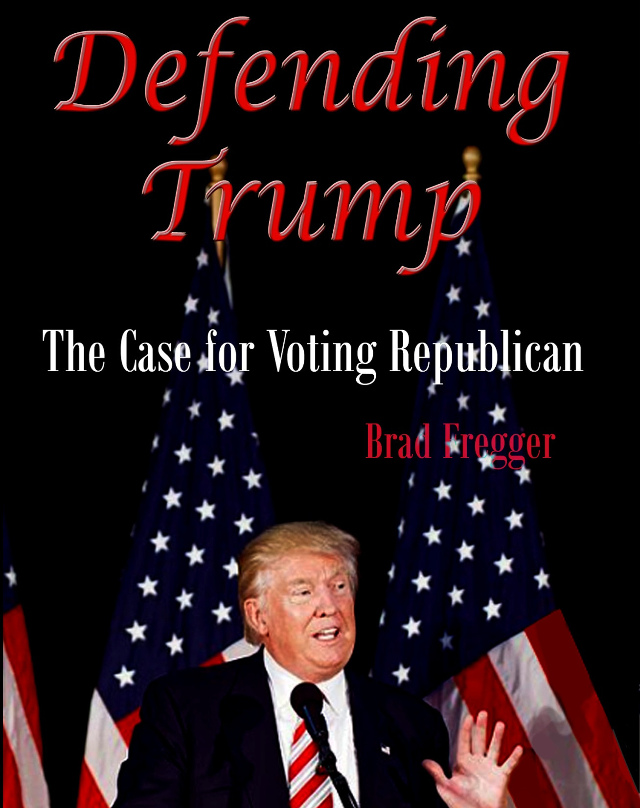
1

Slide 2
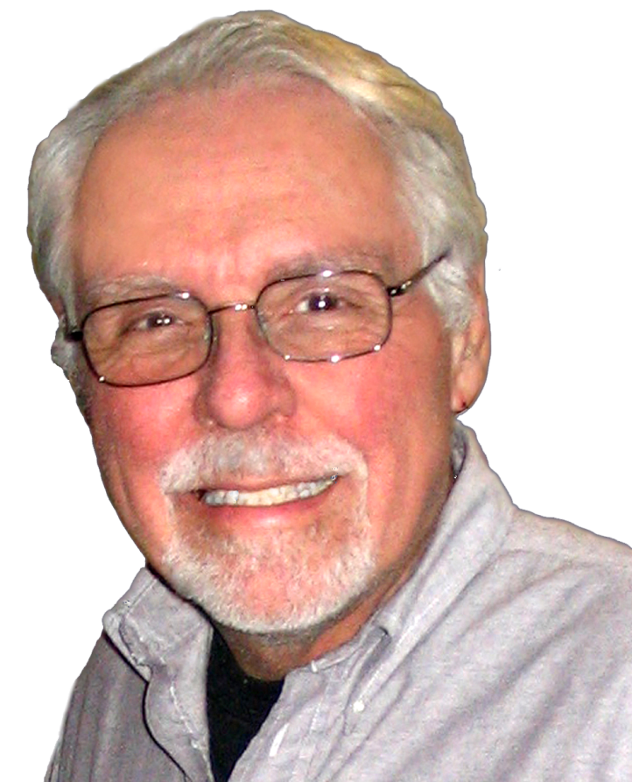
A Bit About Myself
I’ve had seven careers in retailing, consumer software, publishing, and education. I’ve been an international speaker on leadership and negotiation.
My “family” includes, Caucasians, Blacks, American Indians, Christians, Jews, Hindus, Muslims, Gays, Transgenders, Democrats, Republicans, Conservatives, Liberals, Pro-life, Pro-Choice, Warmists, and Climate Realists. I’ve been a lifelong Conservative and Climate Realist.
I have a Master’s degree in Futuristics (Societal Futures) from San Jose State University.
I believe that President Trump has been treated very unfairly by a number of Progressive groups and millions of individuals.
I wrote the book, Defending Trump – The Case for Voting Republican, to right that wrong.
NOTE: The number on the bottom left corner of the page relates to the image attribution at the end of the presentation.
2

Slide 3
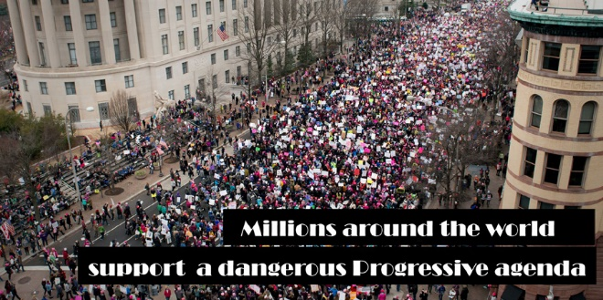
Why Does Trump Need Defending
For the past 4 years he’s been continually attacked with lies, exaggerations, innuendo, and character assassination by:
The Progressive media (NBC, CBS, ABC, CNN, and the Washington Post and New York Times)
The Washington establishment (Democrats, Progressives, and the Republican and Conservative elites identified as Never Trumpers)
Entertainment media (Movies, Television, and Music)
And millions of people who believe everything these influential Progressives say about Trump, without bothering to find out the truth
3

Slide 4
What Are They Saying About Trump?
Here are some examples with comments stating clearly why the accusations are wrong.
He called all Mexicans: crooks, rapists, and murderers, and he hates Blacks, gays, and women. Essentially, he is a anti-gay misogynist, racist, and xenophobe.
Definitely not true, with the Mexican comment, he basically said, Mexico was sending their worst to America that we shouldn’t be allowing crooks, rapists, and murderers into our country.
Regarding Blacks, gays, and women. There has never been a president who supported all three at the level he has. He supports them, not for political reasons, but because he knows it is the right thing to do.
33

Slide 5
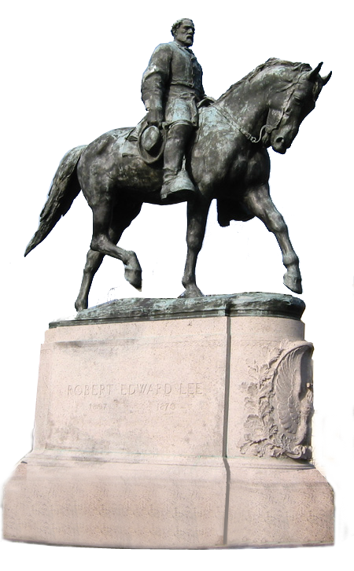
What Are They Saying About Trump?
(con.)
He supported the white supremacists in Charlottesville.
Not true, he stated, that many attending that rally were there to support the belief that the statue of Robert E. Lee should not be destroyed.
In fact, he denounced the antifa and white supremacists who caused the riot that led to the death of a young woman.
4

Slide 6
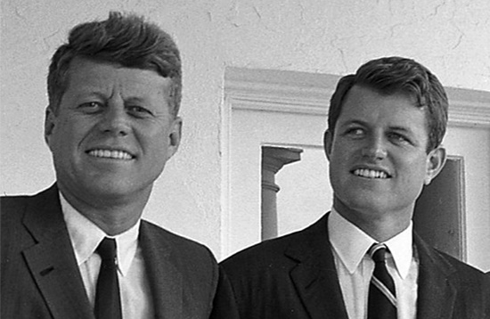
What Are They Saying About Trump?
(con.)
He’s a womanizer, shown by his use of a prostitute and his private conversation with another man regarding his ability, as an extremely wealthy man, to do anything he wanted to a woman including touching her in an intimate place.
Both true, but is this a reason to suggest that he is not worthy of being President? Are we to judge him and, yet, completely ignore that Bill Clinton has been justly accused of rape and molestation by many women and was proven to have seduced a young intern
In the White House; that JFK had intimate relations with women as President, many in the White House; And, his brother Ted is still held in high esteem by these people even though he committed manslaughter. He continued to molest woman throughout his entire career in the Senate.
5

Slide 7
What Are They Saying About Trump?
(con.)
He colluded with the Russians in order to defeat Hillary Clinton for President.
Trump was found innocent of any collusion with the Russians. In fact, it seems that Hillary and the Democrats, actually colluded with foreign entities in order to create a fake dossier to justify: spying on a political opponent, the Mueller investigation, and the impeachment of Trump.
The Progressive media and the Democrats continue to accuse Trump of collusion (suggesting Mueller didn’t find him innocent). These liars or ignorant Progressives need to be reminded that in America we are innocent until proven guilty.
6

Slide 8
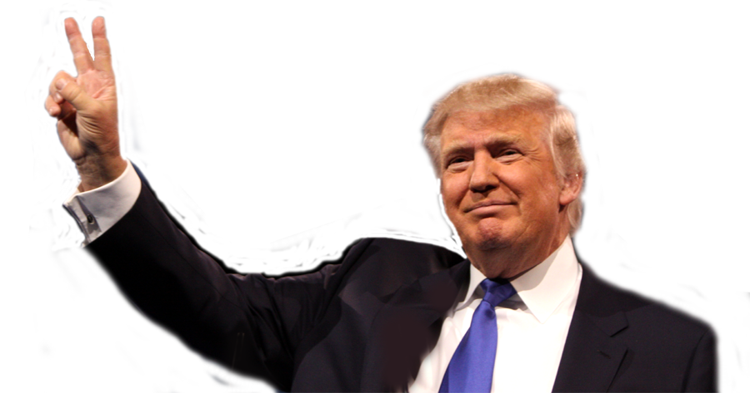
What Are They Saying About Trump?
(con.) He was impeached because he told the Ukraine President to investigate Biden’s son before the Ukraine could get any money or weapons from the United States.
It was known, prior to the impeachment, that Ukraine had received both money and weapons without doing any investigation of Hunter Biden. Trump released the text of the phone call that was the only “proof” of a quid pro quo showing there was no attempt to influence the Ukraine President in any way whatsoever.
The Democrats insisted on the Impeachment. The Senate, of course, acquitted him.
30

Slide 9
What Are They Saying About Trump?
(con.)
He Lies!
Actually, there’s strong support for Trump being one of the most honest and transparent Presidents in history.
Trump has two very different ways of operating. On the one hand, he can be brutally honest with little thought as to the ultimate consequences.
On the other hand, he seems to be in a negotiating mood most of the time. All effective negotiators exaggerate, it’s an effective tool for achieving your objective.
His propensity to exaggerate is one of the reasons that he has won so many battles.
In addition, the fact that he is not a liar should be obvious. No other President has kept as many of the promises made to their constituents as President Trump has; not the sign of a liar.

Slide 10
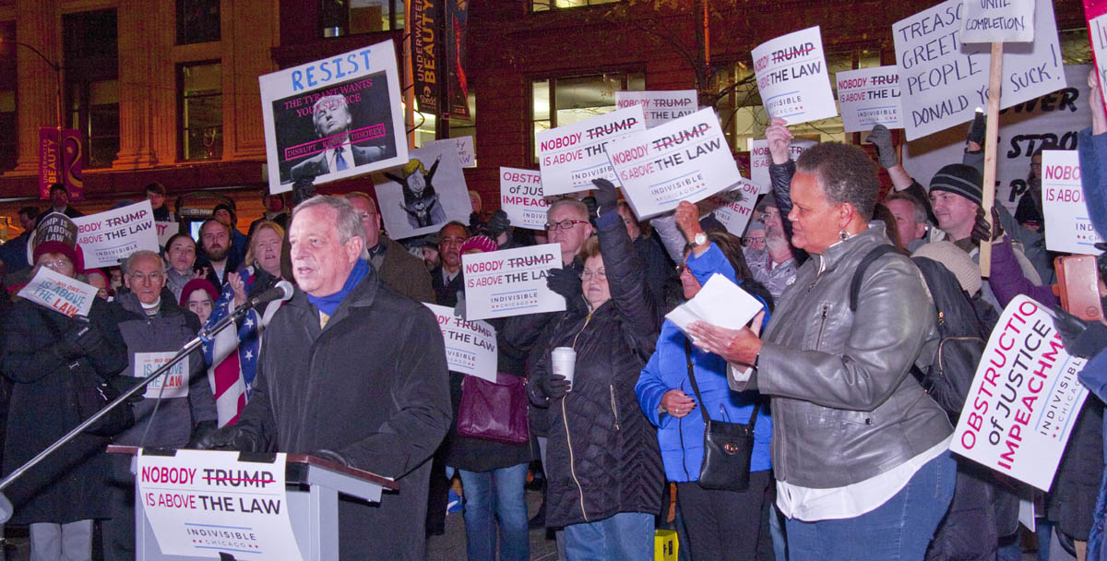
What Has Trump Accomplished?
Before listing some of President Trump’s accomplishments I need to suggest that no modern politician could have withstood the relentless attacks that Trump has been subjected to for the past 3 plus years.
In fact, when you consider that the Mueller Investigation was headed by a Never Trump RINO, supported by 18 lawyers who hated Trump, many of whom had contributed to the Hillary campaign, it is a wonder that they could find only innuendo against Trump, nothing criminal.
I’m willing to bet that not another, successful, Washington politician could have survived that level of scrutiny. It appears, as I have suggested, that Trump may well be the most honest politician in Washington.
7

Slide 11
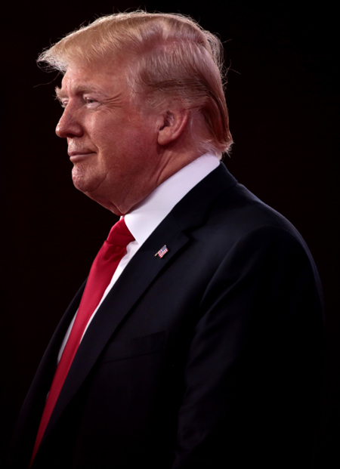
What Has Trump Accomplished?
What Has Trump Accomplished?
Trump’s major success has been the economy. However many, including Obama, want to give the Obama administration credit.
My Master’s in Societal Futures involved research into Images of the future and the concept that powerful, positive images of the future are the engine that drives a society’s socioeconomic success.
I also suggested that a powerful, positive image of the future (Make America Great Again) would have a significant and immediate impact on the current socioeconomic health of the society.
Believing this, I shared with Barbara that, if Trump was elected, the economy would begin to improve dramatically and almost immediately.
Despite the predictions of some famous economists, that is exactly what happened.
8

Slide 12
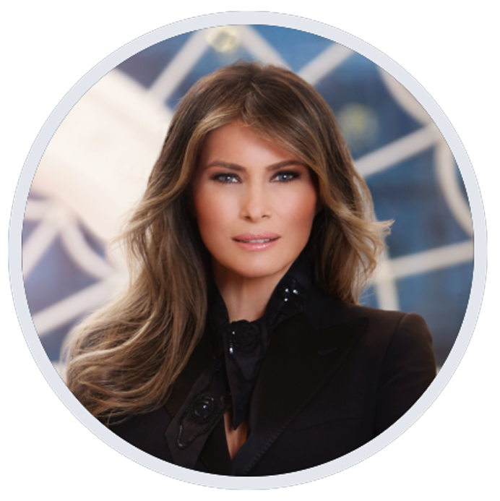
What Has Trump Accomplished?
Below and on the next few pages I show some facts about President Trump, well known to his supporters but mostly hidden from the general public by a progressive media and a Washington establishment determined to remove a duly-elected President of the United States from office, essentially a silent coup.
Trump has 3 children from his marriage to Ivana Zelníčková: Donald Jr., Ivanka, and Eric. They divorced in 1992.
He married Marla Maples in 1993 and had one\daughter, Tiffany who was raised by Marla in California. They divorced in 1999.
In 2005, Trump married Melania, and they have a son, Barron.
Trump is Presbyterian with many influential spiritual advisors, Including: Paula White, Ralph Reed, and Robert Jeffress.
9 & 10

Slide 13
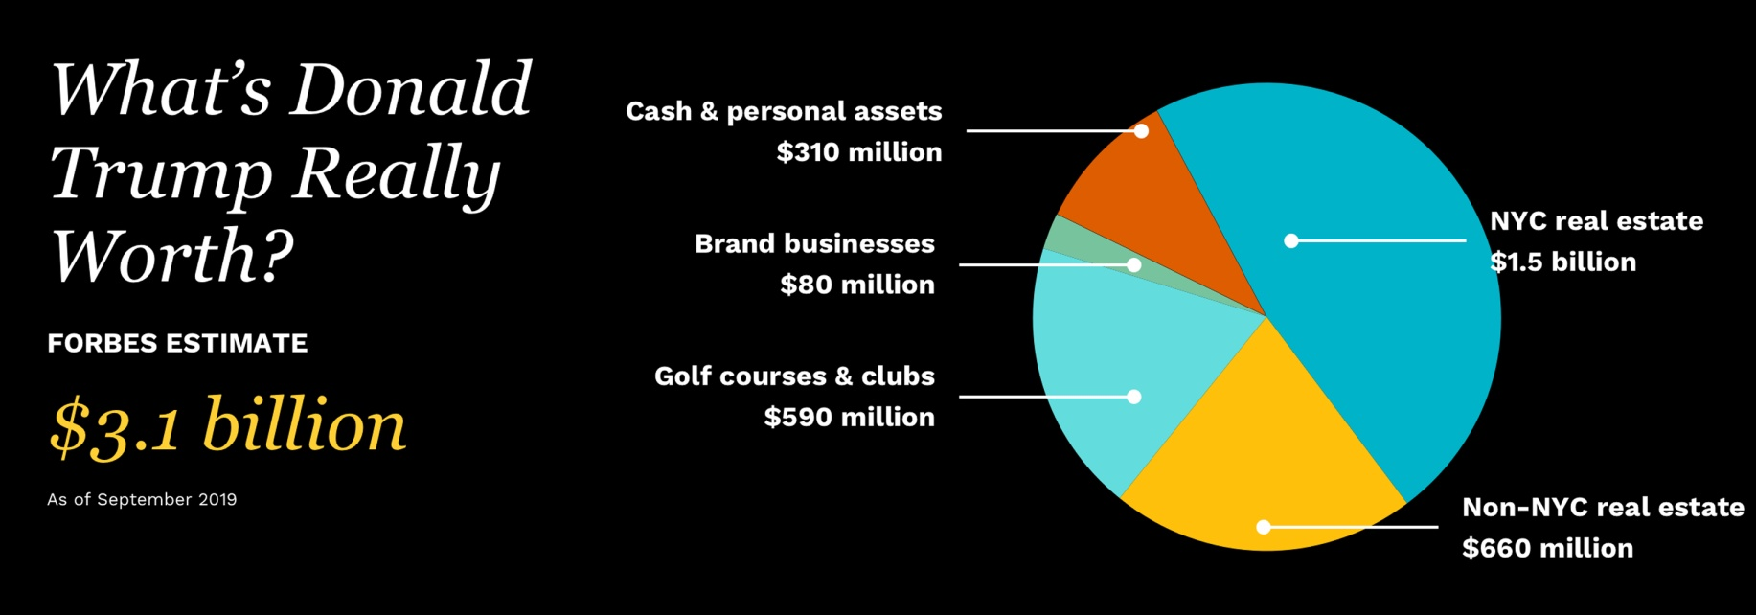
What Has Trump Accomplished?
In Defense of President Trump
Business Accomplishments
Trump received approximately $4oo million from his dad. However, Trump's net worth was $3.1 billion in the 2018 Forbes 400 listing.
Trump is hardly a “failure and fraud.”
11

Slide 14
What Has Trump Accomplished?
In Defense of President Trump
Presidential Accomplishments
The complete list of his accomplishments as President would be much too long for this presentation. The White House lists a total of 319 as of this writing.
While you may not agree with them all, the majority of those who voted for him are delighted, as are a great number who didn’t vote for him.
I’ve chosen a few of the most significant:
The Pledge to America’s Workers resulted in employers committing to train more than 4 million Americans.
3.9 million Americans lifted off food stamps since the election.
Passed the tax cuts and jobs act, which led to 7 million jobs being added to the economy and 2.4 million Americans being lifted out of poverty.
More Black, Hispanic-, and Asian-Americans employed than ever before in history.
Lowest unemployment in history for those without a high school diploma.

Slide 15
What Has Trump Accomplished?
Presidential Accomplishments
Trump’s accomplishments as President.
Withdrew the United States from the disastrous Paris Climate Agreement.
U.S. oil production at an all-time high.
Negotiated a new and fairer trade agreement with Canada and Mexico.
Negotiated the phase 1 trade agreement with China.
Convinced North Korea to stop its nuclear and long-range missile testing.
Launched an unprecedented attack on drug prices.
Signed the First Step Act designed to make our justice system fairer.
Record number of regulations eliminated.
Enacted regulatory relief for community banks and credit unions.
Obamacare individual mandate penalty repealed.

Slide 16
What Has Trump Accomplished?
In Defense of President Trump
Presidential Accomplishments
Trump’s accomplishments as President.
As of September 30, 2019, the United States Senate has confirmed 152 Article III judges, including 2 Associate Justices of the Supreme Court of the United States, 43 judges for the United States Courts of Appeals, 105 judges for the United States District Courts, and 2 judges for the United States Court of International Trade.
He is following through on his promise to build a wall on our southern border. Approximately 450 miles of new border wall will be built by the end of 2020.
FDA is approving more affordable generic drugs than ever before in history and many drug companies are freezing or reversing planned price increases.
Reformed the Medicare program to stop overcharging low-income seniors on their drugs—saving seniors hundreds of millions of dollars this year alone.
Signed Right-To-Try legislation.

Slide 17
The Silent Coup
In Defense of President Trump
There’s a Tradition in Our Country
Before I make a case for the “Silent Coup” I want to remind you of an instance that occurred during the final presidential debate (2016) hosted by Chris Wallace of Fox News. Trump was concerned that the election was being rigged against him so,
Wallace asked, “Will you absolutely accept the results of this election?”
Trump responded, “We will look at it at the time. I’m not looking at anything now, I will look at it at the time."
Wallace, very surprised, replied, “There is a tradition in our country … the peaceful transition of power … that the loser concedes to the winner … are you saying you're not prepared to commit to that principle?
Trump replied, "I will keep you in suspense.“

Slide 18
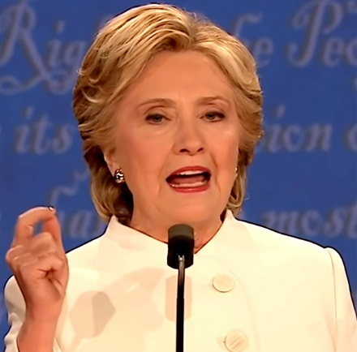
The Silent Coup
Wallace did not ask Hillary the same question. However, she chose to respond,
"Well, Chris, let me respond to that. Because that’s horrifying. … That is not the way our democracy works. We’ve been around for 240 years, we’ve had free and fair elections, we’ve accepted the outcomes when we may not have liked them, and that is what must be expected of anyone standing on a debate stage in a general election.”
Nixon accepted the results of the election between him and JFK when there was strong evidence of wrong doing. However, neither Kerry nor Gore accepted their losses to Bush, even though there was no evidence of foul play.
While you would expect Hillary to ignore that fact, it is somewhat surprising that Wallace ignores it. It is this type of behavior that makes Wallace look like a full-paid member of the Washington establishment.
The attempt to remove Trump from office by “impeachment” is the Democrats most recent, and most atrocious, instance of ignoring “tradition in our country.”
31

Slide 19
The Silent Coup
In Defense of President Trump
So, what is the definition of a Coup?
A sudden attempt by a small group of people to take over the government usually (but not always) through violence. The dictionary lists two main types, I will add a third.
a military coup d'état
a bloody coup d'état
a silent coup d'état
The definition states that a coup is an attempt by a “small group of people.” This “silent coup,” is anything but a “small group” attempting to take over the government.
In fact, those involved include the Washington establishment, the Democratic Party, and the mainstream media.. With the full support of a majority of Hollywood and ignorant liberals (probably close to 25 percent of the population).
Notes:
e

Slide 20
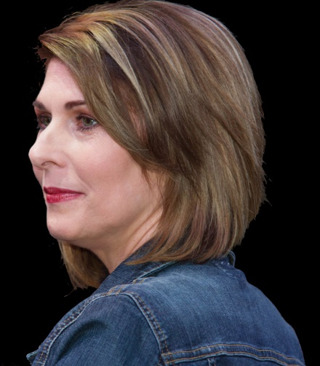
The Silent Coup
In Defense of President Trump
No Collusion
The findings of the Mueller investigation, clearly stated in his report to the DOJ were, as reported by Sharyl Attkisson, “ Special Counsel Robert Mueller signs off on his final report stating that there was no collusion or coordination between Trump — or any American — and Russia. He leaves as an open question the issue of whether Trump took any actions that could be considered obstruction. No new charges are recommended or filed with the issuance of the report.”
“No collusion” means Trump was totally innocent of those charges of which he had been accused thousands of time in the previous two years, in fact, there are still unethical politicians and media people suggesting he was guilty of collusion and treason. In a sane world these politicians and pundits would be guilty of both slander and libel.
12
Notes:
e

Slide 21
The Silent Coup
No Obstruction
Regarding the issue of obstruction. Mueller was unwilling to accuse Trump of obstruction and passed the ball to the DOJ. The DOJ, after a thorough reading of the evidence, stated that there was not any evidence showing criminal obstruction and, therefore, as far as they were concerned, the case was closed.
This too was unacceptable to the Washington establishment, the Democrats, and the mainstream media. Muller, while not accusing Trump of obstruction, had, in the second part of his report, listed numerous behaviors and activities that were an attempt at character assassination.
However, the Democrats jumped on this bandwagon as proof of Trump’s unacceptability as President of the United States and proceeded full steam ahead on their objective to remove him from office and destroy his and his family’s credibility for generations to come.
Notes:
e

Slide 22
The Silent Coup
In Defense of President Trump
The Dossier
Plans were afoot to remove Trump from office even before his inauguration. The objective was to brand Trump as a traitor in collusion with the Russians, especially Putin, to steal the election from Clinton.
The Democrat Party and the Hillary Campaign hired Fusion GPS to do political research on Trump, including possible connections with Russia. In June of 2016 Fusion GPS hired a former British intelligence agent to use his sources in Russia to “dig up dirt” on Trump.
This nefarious activity produced the fake dossier which the FBI used to lie to the FISA court in order to obtain permission to spy on the Trump campaign.
The coup was on, every weapon was used, including, lies, innuendo, misrepresentation, and character assassination, to convince the public that Trump was in league the with Russians.
The truth, it was Hillary and the Democrats who were in league with foreign entities, including the Russians.
Notes:
e

Slide 23
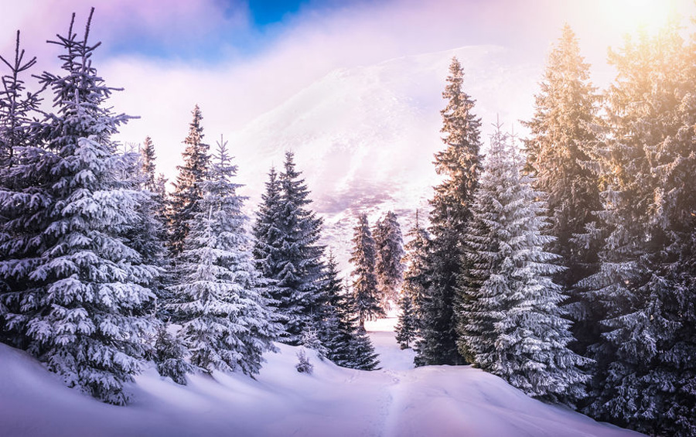
The Silent Coup
The Silent Coup
In Defense of President Trump
Pure as the Driven Snow
As I stated earlier, Trump was not only found innocent by the Mueller investigation, Which I imagine drove them, literally, crazy. In fact, they couldn’t find as much as a traffic ticket to accuse him of.
But they are not through. In their minds, Trump must be removed from office, he is not only embarrassing them with his numerous accomplishments, regardless of their many attempts to stop him, but he is also a major block in their attempt to change America in the a Socialist state, actually a Progressive theocracy (Socialism on steroids).
13

Slide 24
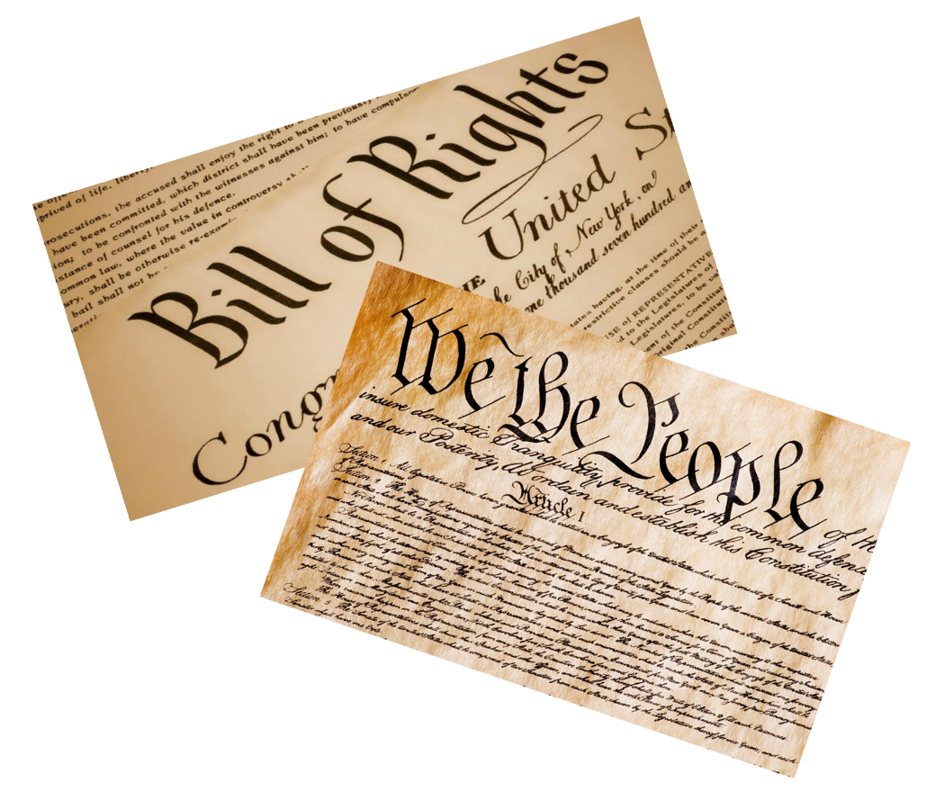
Progressivism: Socialism on Steroids
The ultimate goal of the Progressive Movement is a Progressive-Socialist (PS) country. A PS country is a country without the American Constitution and Bill of Rights.
These documents guarantee civil rights and liberties “endowed by their Creator,” to every citizen in the United States regardless of gender, race, religion, or sexual orientation.
All socialist countries have an all-powerful central government. The Constitution and especially the Bill of Rights, limit the power of the central government, giving freedom and liberty to the individual and most governmental power to the states.
This is why those in favor of socialism are opposed to the freedoms promised in our most cherished documents.
14

Slide 25
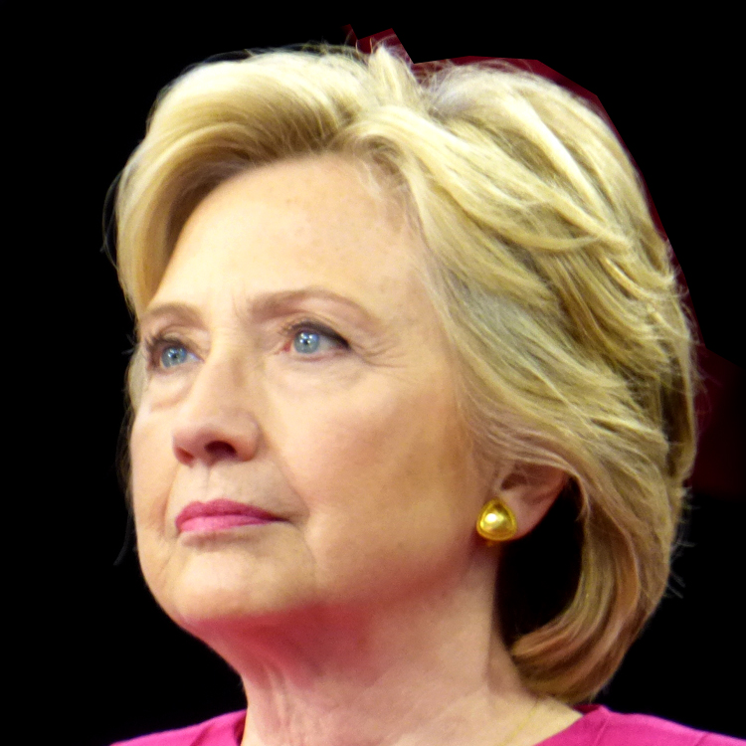
Progressivism: Socialism on Steroids
Under a PS society the individual has no rights beyond those which are provided by the government. The government is the ultimate source for all individual needs and desires.
Actually all politicians, members of the military, etc. who promised to protect the Constitution from enemies foreign and domestic and are, yet, supporting the Progressive Movement have broken that vow and are, therefore, traitors and should be treated as such.
One of Trump’s greatest accomplishments was saving us from Hillary Clinton. Her election would have, ultimately, lead to a PS society. No other potential candidate could have garnered the support needed to defeat Clinton; Trump literally saved America.
32

Slide 26
Progressivism: Socialism on Steroids
Progressivism vs. Conservatism
Listed below are a number of Conservative Statements (CS) on basic societal issues, followed by how the Progressive Movement (PM) views the issue. I also comment in order to provide greater clarity.
CS: Every person of every race, religion, gender, and sexual orientation deserves their chance at happiness; the pursuit of happiness is a God-given right.
PM: Women, gays, Blacks, etc. are deprived of happiness because of the actions of others.
Progressives create victims and therefore steal the opportunity for happiness from those they profess to be helping.
15

Slide 27
Progressivism: Socialism on Steroids
Progressivism vs. Conservatism
CS: Everyone should have the opportunity to reach their potential and, thereby, experience a level of success, personal and financial, that matches their dreams, hopes, and expectations.
This is equal opportunity, not equal outcome.
PM: The goal is equal outcome. It is unfair that some succeed and others fail.
This, of course, is ridiculous to the extreme. \People are different, it is impossible to create equal outcome; we all have our advantages and disadvantages, our strengths and weaknesses.
16

Slide 28
Progressivism: Socialism on Steroids
Progressivism vs. Conservatism
CS: Everyone should be treated equally in life, career, and education; everyone should be treated with respect, until such time they prove they are unworthy of respect
PM: Those supporting Progressivism are treated differently than those who challenge their beliefs and resulting policies.
Therefore, they treat Clarence Thomas and Brett Kavanaugh very differently from how they treat Bill Clinton and Ted Kennedy.
17

Slide 29
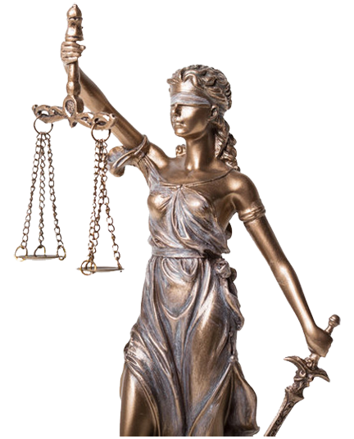
Progressivism: Socialism on Steroids
Progressivism vs. Conservatism
CS: No one, no one, should receive special treatment under the law; Lady Justice wears a blindfold for a reason.
PM: Powerful Progressives will be judged differently than the “common” folk.
Hillary’s criminal behavior regarding her unauthorized server and emails were essentially ignored while a sailor, who innocently took some pictures of his nuclear sub, was sentenced to a year in jail and branded a felon for the rest of his life.
18

Slide 30
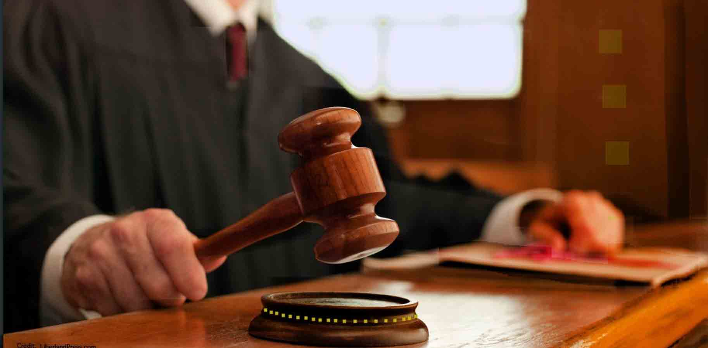
Progressivism: Socialism on Steroids
Progressivism vs. Conservatism
CS: Our laws must be followed. Bad or worthless laws should be changed, but until they are changed, those breaking, for whatever reason, must accept the penalty for their actions.
PM: Ignore any law that opposes a Progressive belief until such time that a Progressive judge can find the law unconstitutional.
Our laws concerning illegal aliens are completely ignored by Progressive politicians, judges, and sanctuary cities. For example: Title 8 U.S. Code § 1325.Improper entry by alien
19

Slide 31
Progressivism: Socialism on Steroids
CS: A strong federal government (even worse, world government) will inevitably take away freedom and liberty from the people, drastically limiting opportunities for individuals to achieve happiness and success.
PM: What must be accomplished can only be accomplished by a strong central government. With the large, critical issues threatening the entire world, a world government is necessary to make sure that what needs to be done gets done.
The elite will “save the world.” In their ignorance, they believe that we are not capable of making the right decisions for ourselves, our communities, the nation, or the world.
20

Slide 32
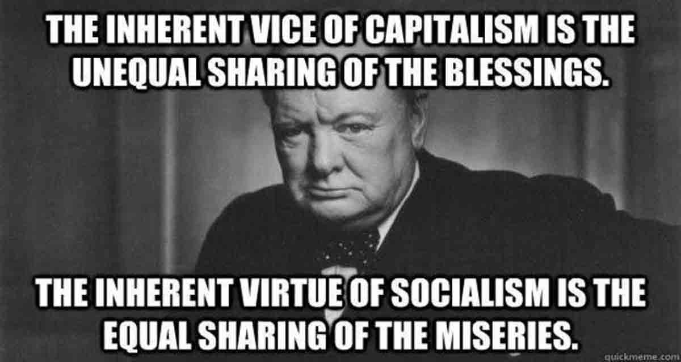
Progressivism: Socialism on Steroids
Progressivism vs. Conservatism
CS: The vast majority of people know what’s best for themselves and their families and that no government, especially a central government, can make better decisions for them.
PD: The central government under the control of Progressive wisdom provides the policies, laws, and culture that allows the general public to find peace and happiness; that assures that everyone of every race, nationality, gender, and sexual orientation is treated fairly.
21

Slide 33
Progressivism: Socialism on Steroids
Progressivism vs. Conservatism
CS: The Constitution and Bill of Rights states clearly our personal rights and responsibilities. We must protect what our founders created from all enemies both foreign and domestic.
PD: The Constitution and especially the Bill of Rights only tell us what government can’t do, we must have a Bill of Rights that tells us what the government can do to make life better, safer, fairer for every person living in the United States.
22

Slide 34
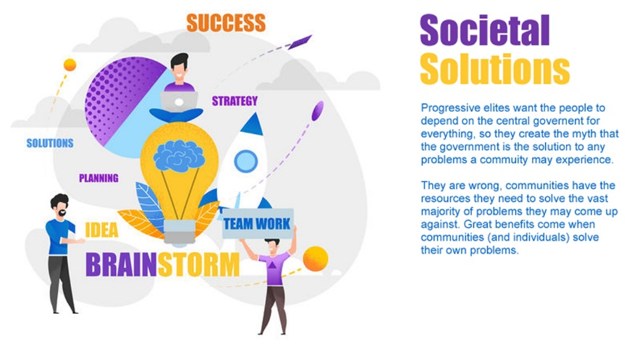
Progressivism: Socialism on Steroids
CS: When people do find themselves in need of help, the best help comes from their community. When the federal government steps in and tries to help, they take power and influence from the community and exacerbate the problem.
PM: The federal government is the best source of help for those in need. Local communities, even states, often don’t have the resources needed to get done what must get done.
Much of the time, the federal government fails, leaving many no better off. Even when they succeed, the local community would still have done a better, more loving job.
23

Slide 35
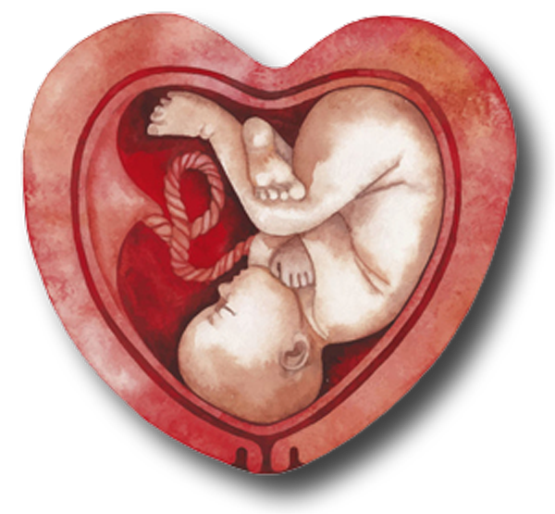
Progressivism: Socialism on Steroids
Progressivism vs. Conservatism
CS: Every human life is precious. Killing a human, whether in the womb or walking down the street, is murder, an evil deed worthy of damnation.
PM: Baby’s may be aborted during the third trimester. In fact, even a living, aborted child may be killed at the request and approval of the mother.
It is even worse, medical Progressives are suggesting that a baby should not be identified as human at birth with some stating that the baby must be at least a year old. Exactly when a baby is human and worthy of life-saving technologies is under consideration amongst those who have little value for human life.
24

Slide 36
Progressivism: Socialism on Steroids
Progressivism vs. Conservatism
CS: Doing what is right, trumps any material or personal gain.
PM: Whatever moves the agenda forward is not only acceptable but morally right.
“The third rule of ethics of means and ends is that, in war the end justifies almost any means.” - Saul Alinsky
25

Slide 37
Progressivism: Socialism on Steroids
Progressivism vs. Conservatism
CS: The presumption of innocence is critical to the survival of a Democratic Republic. Without it, the good fear unwarranted attacks, leaving evil to take over the country.
PM: The presumption of innocence is only for the faithful. Those who oppose us are immediately judged guilty and must prove their innocence to the court of public opinion, and when we have won, to our local and federal courts.
This is so obvious, what Progressives believe is displayed clearly in regard to how both Trump was treated in the Russian Collusion fraud and how Kavanagh was treated in his confirmation hearing; vs. how Clinton was treated in regard to many issues, especially her destroying of thousands of emails, some containing sensitive government information.

Slide 38
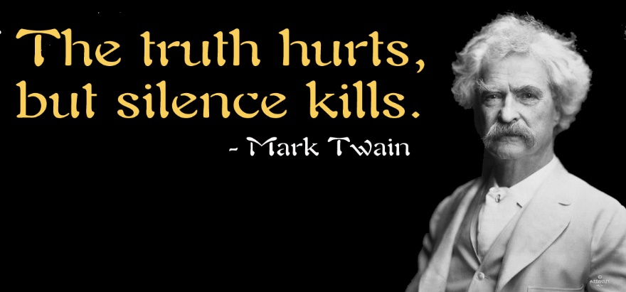
Progressivism: Socialism on Steroids
Progressivism vs. Conservatism
C: Conservatives are committed to the truth, even when it hurts, even when it questions one of their cherished beliefs.
PD: The search for truth is a waste of time, the result of ignorance and a lack of faith in those who know the truth. All that matters is what we know to be true. Any opposing view must be destroyed before it causes doubts in our followers.
Prior knowledge, opposing scientific research, and the possibilities of catastrophic unintended consequences are ignored.
26

Slide 39
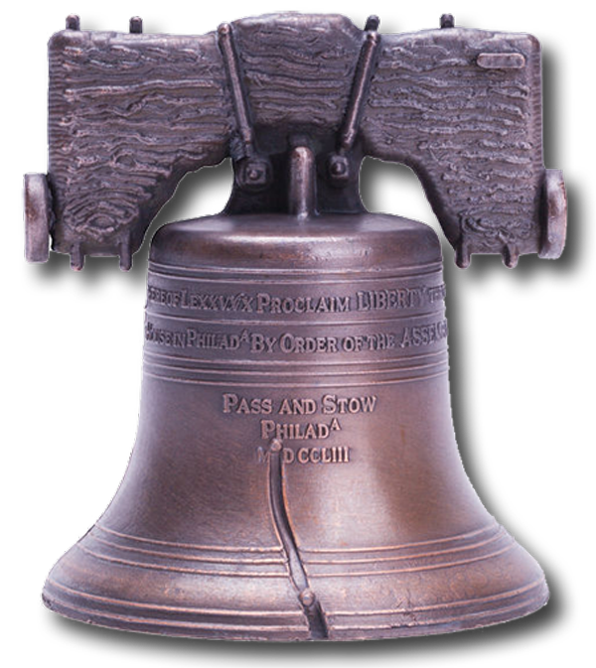
Progressivism: Socialism on Steroids
Progressivism vs. Conservatism
CS: Conservatives believe that Capitalism (not crony capitalism which conservatives do not support) has brought more of the world’s people out of starvation and suffering than any other economic system in the history of the world. Our Democratic Republic combined with Capitalism has been a beacon leading to more peace and equality than ever before in history.
It is natural that some have more than others; there will always be different talents, different objectives, and different levels of commitment.
PM: Capitalism creates winners and losers; success is not an individual’s achievement, the government made that success possible by what it provides. It is wrong that some have more than others. The government has the right, the responsibility, to take from one and give to another.
27

Slide 40
Progressivism: Socialism on Steroids
CS: There is a Universal Consciousness that makes up the entire Universe and everything in it. Some call it God, some Allah, some Nature, some the Creative Intelligence, and some the Sun God.
PM: There is nothing more powerful than a central government. That is what the people must depend on, not the fantasy of something powerful beyond this world.
Progressives, like the communists, cannot allow the “worshiping” of any entity beyond the Progressive government. They demand that the people be dependent on the central government for all of their desires and needs. Ultimately, “religious” symbols (images of Christ, Buda, Maharishi/Guru Dev, etc.) will be removed and replaced with images of the supreme ruler (as is now taking place in China).
28

Slide 41
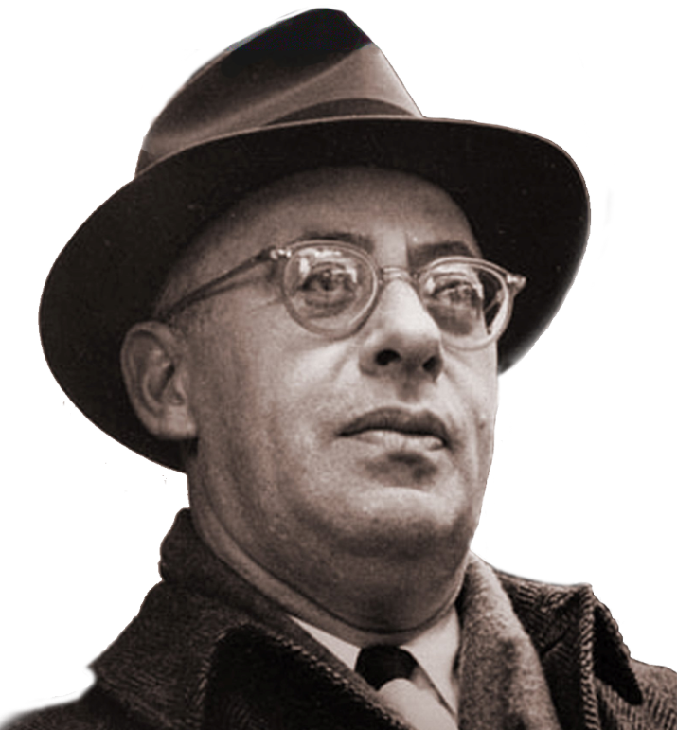
Saul Alinsky
It is important to understand who Saul Alinsky was. He was the modern father of revolutionary change, considered to be the most important community organizer in history, His book, Rules for Radicals, is the bible for those who desire radical social change.
Hillary Clinton wrote her college thesis on Alinsky and Barack Obama’s political activities are said to have been strongly influenced by Alinsky ‘s writings. In addition Obama wrote an essay in a book honoring Alinsky.
In addition, the Progressive social movement treats Rules for Radicals as their bible for creating the changes that they are committed to.
On the following pages are a few quotes from Alinsky ‘s speeches and his book, Rules for Radicals.
29

Slide 42
Saul Alinsky
Saul Alinsky Quotes
The problem is: Alinsky’s methods for bringing about social change:
“They have the guns and therefore we are for peace and for reformation through the ballot. When we have the guns then it will be through the bullet.”
“Never let a crisis go to waste.”
“Control health care and you control the people.”
“The thirteenth rule of radical tactics: Pick the target, freeze it, personalize it, and polarize it.”
“The despair is there; now it’s up to us to go in and rub raw the sores of discontent, galvanize them for radical social change.”

Slide 43
Saul Alinsky
Saul Alinsky Quotes
“The Haves publicly pose as the custodians of responsibility, morality, law, and justice, they can be constantly pushed to live up to their own book of morality and regulations. No organization, including organized religion, can live up to the letter of its own book. You can club them to death with their “book” of rules and regulations.”
“True revolutionaries do not flaunt their radicalism. They cut their hair, put on suits, and infiltrate the system from within.”
“The most unethical of all means is the non-use of any means.”
“The establishment can accept being screwed, but not being laughed at.”
“The threat is generally more terrifying than the thing itself.”

Slide 44
Saul Alinsky
Saul Alinsky Quotes
“To the man of action the first criterion in determining which means to employ is to assess what means are available. Reviewing and selecting available means is done on a straight utilitarian basis — will it work? Moral questions may enter when one chooses among equally effective alternate means.”
“If the organizer begins with an affirmation of love for people, he promptly turns everyone off. If the other hand, he begins with a denunciation of exploiting employers, slum landlords, police shakedowns, gouging merchants, he is inside their experience and they accept him.”
This last quote is exactly how the Nazis convinced the populations of Europe, especially Eastern Europe that the Jews were the source of all of their problems. This evil is beginning again in Europe and America.

Slide 45
The End

Slide 47
This Presentation Was Created by:
Permission to use is granted with an attribution to:
Brad Fregger, Groundbreaking Press (www.groundbreaking.com)

Slide 48
Image Attributions
1-Cover: Image by Michael Vadon - Own work, CC BY-SA 4.0, https://commons.wikimedia.org/w/index.php?curid=51483075 This version, with major design changes (Ivanka removed and image cropped), own work.
2-Brad Fregger: Own work
3- Millions: Own Work
4. Robert E. Lee Statue: Own Work
5. JFK & Ted: Public Domain
6. Russian Insignia: Public Domain
7. Protesting Trump: By Charles Edward Miller from Chicago, United States - Protest Trump and Protect the Mueller Investigation Rally and March Downtown Chicago Illinois 11-8-18 5051, CC BY-SA 2.0, https://commons.wikimedia.org/w/index.php?curid=74278926
8. Trump Profile: By Gage Skidmore from Peoria, AZ, United States of America - Donald Trump, CC BY-SA 2.0, https://commons.wikimedia.org/w/index.php?curid=66881486
9. Tiffany Trump: Public Domain
10. Melania Trump: White House official official portrait, which was taken by Belgian photographer Regine Mahaux
11. What is Trump really worth: Forbes
12. Sharyl Attkisson: By Redneck Country Club - https://www.flickr.com/photos/theredneckcc/15951945641/, CC BY 2.0, https://commons.wikimedia.org/w/index.php?curid=76997230
13. Snow Scene: Andrii Vergeles – Ukraine
14. Bill of Rights, Constitution: Own Work
15. Religious Symbols: Own Work

Slide 49
Image Attributions, con.
16. Opportunity to reach potential: Own Work
17. Everyone should be treated equally in life (Bill, Ted, Clarence, Brett): Own Work
18. Lady Justice: By Kaspars Grinvalds, purchased from 123RF
19. No one is above the law: By Charles Edward Miller from Chicago, United States - Protest Trump and Protect the Mueller Investigation Rally and March Downtown Chicago Illinois 11-8-18 5051, CC BY-SA 2.0, https://commons.wikimedia.org/w/index.php?curid=74278926
20. Communism is murder: Own Work
21. Winston Churchill: Own Work
22. Bill of Rights & Constitution: Own Work
23. Societal Solutions: Own Work
24. Baby in Heart Womb: By Ekaterina Glazkova, purchased from 123RF
25. Leo Tolstoy: Public Domain
26. Mark Twain Quote: Own Work
27. Liberty Bell: By pixelrobot, purchased from 123RF
28. Sun God: By fi:Käyttäjä:kompak; improving by User:Perhelion - Own work based on: Nefertari tomb, CC BY-SA 3.0, https://commons.wikimedia.org/w/index.php?curid=474147
Saul Alinsky: Public Domain
Trump Victory Sign: Trump Victory Sign: By Gage Skidmore from Peoria, AZ, United States of America - Donald Trump, CC BY-SA 2.0, https://commons.wikimedia.org/w/index.php?curid=42651441
Hillary Clinton: Captured from YouTube video of ABC News telecast
Hillary Clinton, Superior Look: By neverbutterfly - post-DNC rally, CC BY 2.0, https://commons.wikimedia.org/w/index.php?curid=57597316
Trump, Dangerous: By Alisdare Hickson from Canterbury, United Kingdom - The Most Dangerous Person in the World, CC BY-SA 2.0, https://commons.wikimedia.org/w/index.php?curid=70930613. Added additional text.

